Slide 1




PRESENTED BY
Dharmik Patel - 23BCE528

Slide 2



Zepto
What is Zepto?
Zepto is a quick commerce platform that delivers groceries and essentials within 10 minutes.
It operates on a dark store model, ensuring fast and efficient deliveries.
App-based seamless ordering experience

Slide 3

Zepto
Features of Zepto
10-minute delivery model via an extensive dark store network (550+ locations).
Wide product selection, including groceries, daily essentials, and fresh produce.
Technology-driven optimization for order fulfillment and logistics.
Strong investor backing, raising $1.85 billion in funding so far.

Slide 4
Zepto
Competitors of Zepto
Blinkit (owned by Zomato)
The market leader with a 46% share, offering 10-minute deliveries with a strong presence in urban areas.
Swiggy Instamart
Holding a 25% market share, it competes by leveraging Swiggy’s existing customer base.

Slide 5
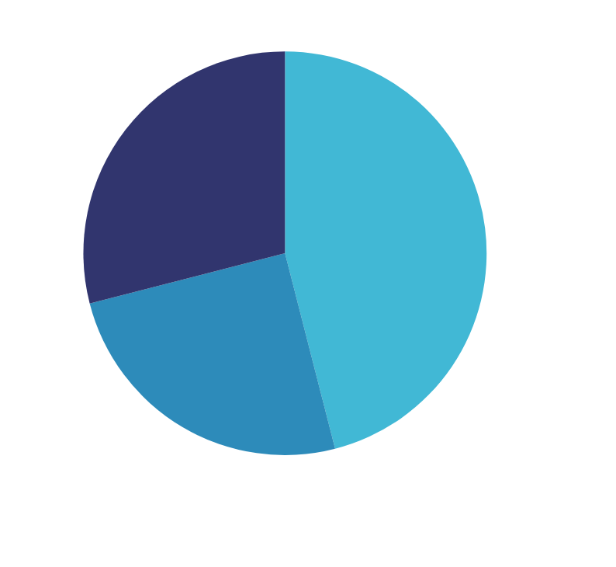
Zepto
source :- https://ipocentral.in/
Market Share
Market Share
Zepto holds 29% of the quick commerce market in India.
Blinkit leads with 46%, while Swiggy Instamart holds 25%.
Revenue Growth
Zepto reported ₹4,454 crore in revenue for FY24.
Competitive Position
Ranked 2nd in India's quick commerce sector.

Slide 6
Zepto
Research Objective
Provide insights and recommendations to boost Zepto’s market share and customer retention.
Analyze gaps between expected and actual service quality to identify improvement areas.
Suggest strategies for service enhancement, operational efficiency, and customer engagement.

Slide 7
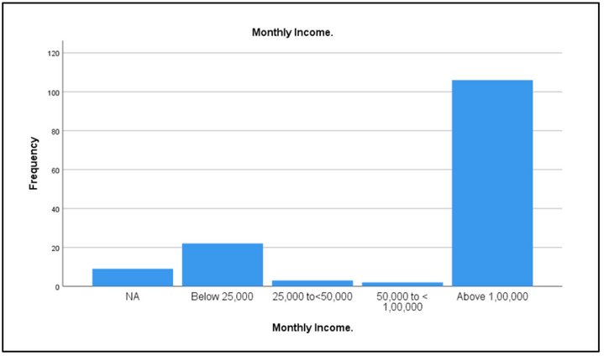
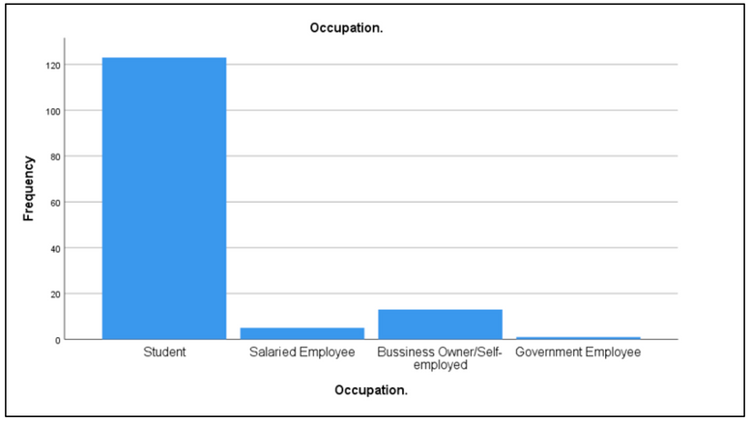
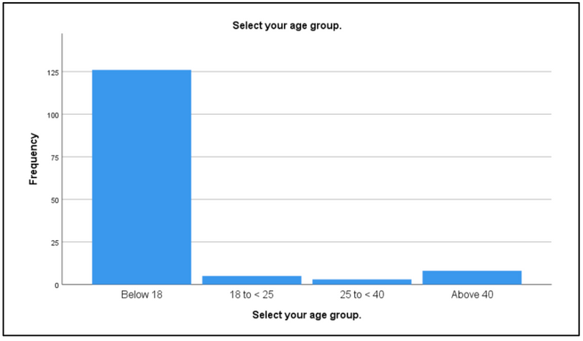
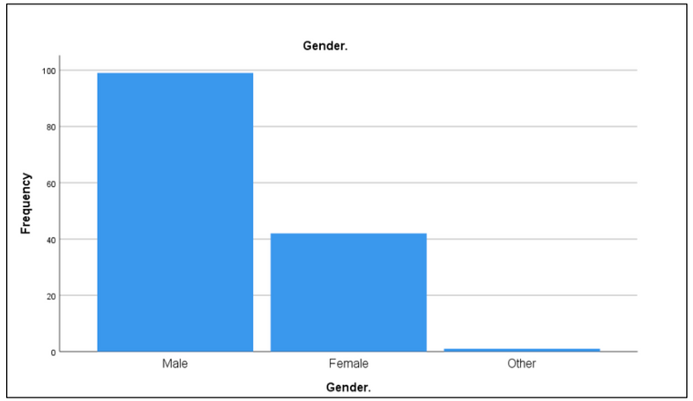
Zepto
Frequency Analysis
Monthly Income
Occupation
Age
Gender

Slide 8
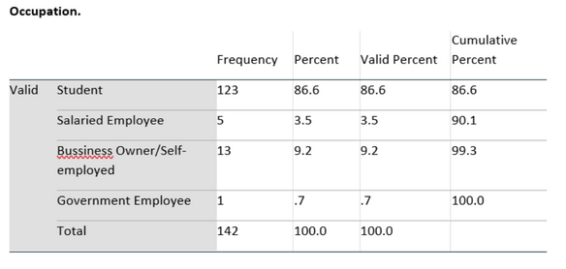
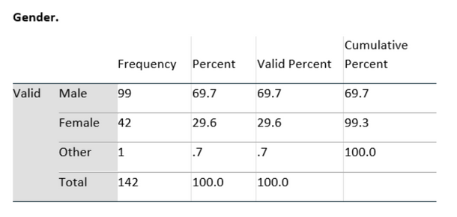
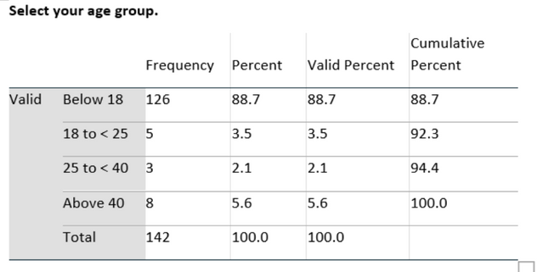
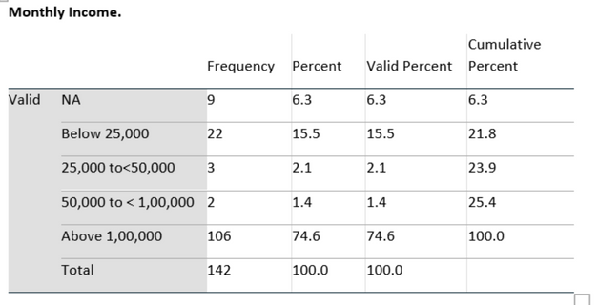
Zepto
Frequency Analysis
49.3% are occasional users, while only 7.7% shop daily, indicating Zepto is not a primary shopping service.
Students dominate (86.6%), with minimal representation from working professionals.
88.7% of respondents are below 18 years, limiting insights for adult consumers.
High-income households (74.6%) dominate, while lower-income groups (15.5%) are underrepresented.
Male respondents (69.7%) significantly outnumber females (29.6%).
The sample is highly skewed towards young, affluent students, affecting market generalizability.

Slide 9
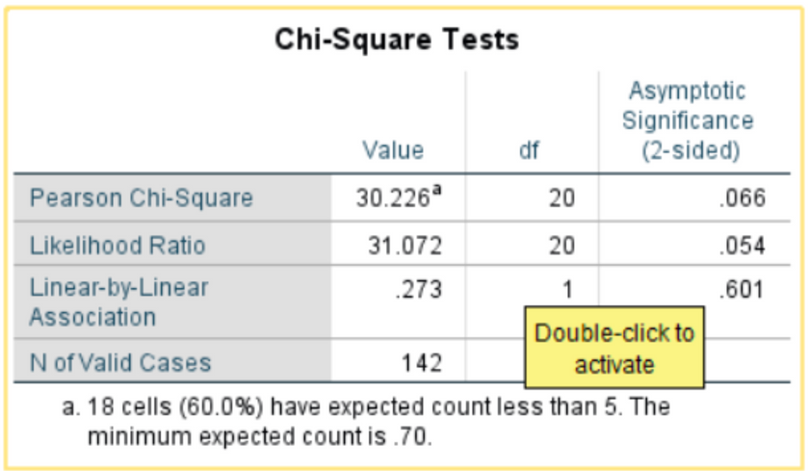
Zepto
Chi Square Test
Hypothesis:
H0: There is no significant association between overall satisfaction with Zepto and frequency of Zepto usage.
H1: There is a significant association between overall satisfaction with Zepto and frequency of Zepto usage.

Slide 10
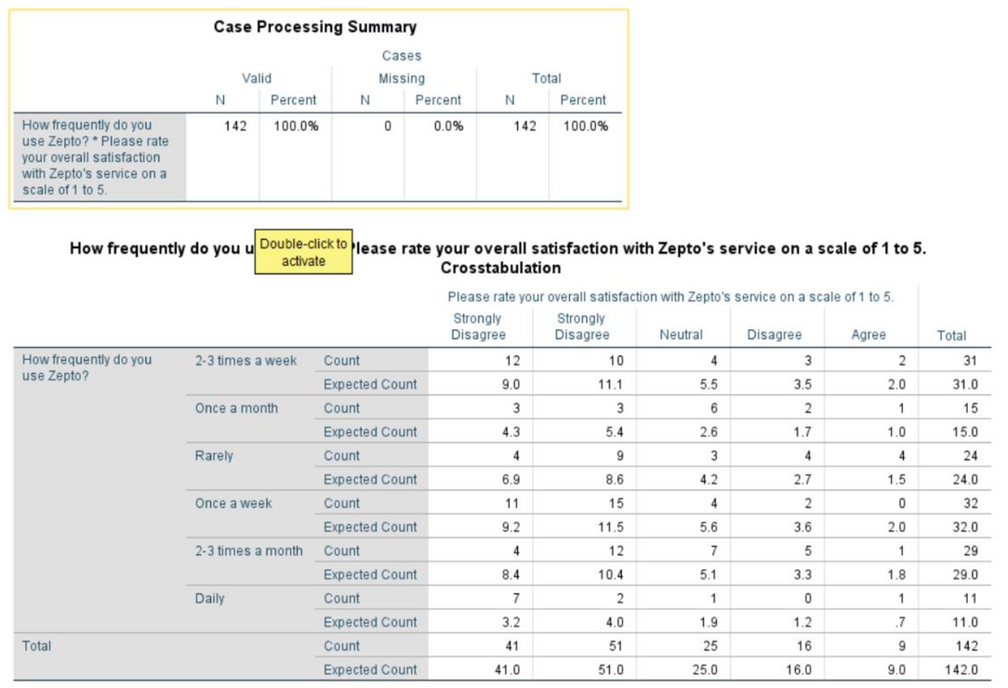
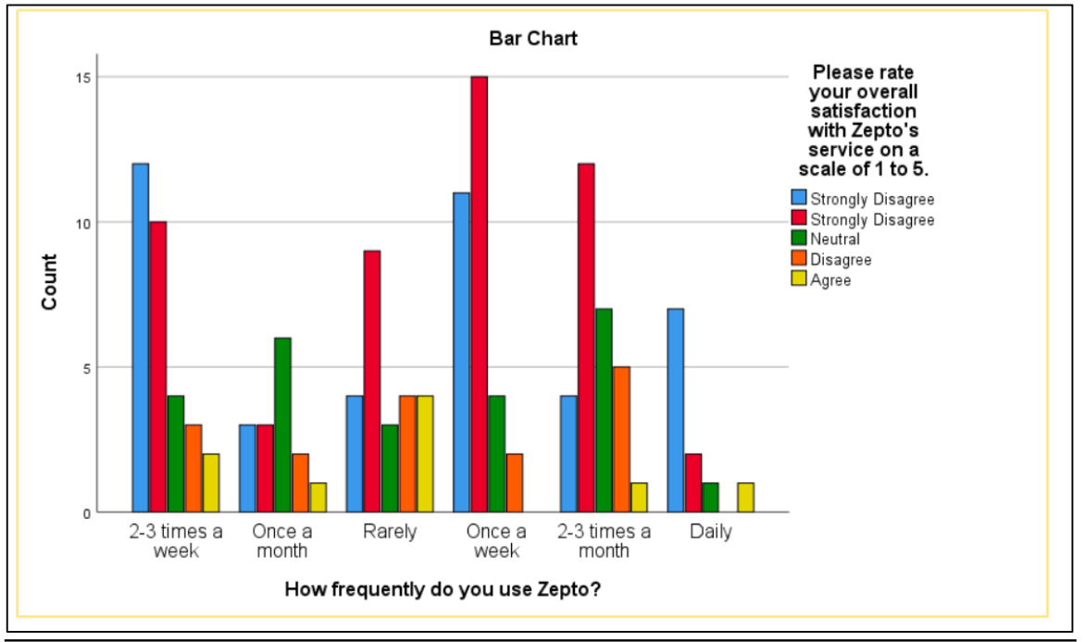
Zepto
Chi Square Test

Slide 11
Zepto
Chi Square Test
Interpretation:
The p-value (0.066) is greater than 0.05, meaning we fail to reject the null hypothesis (H₀).
This suggests that there is no statistically significant relationship between usage frequency and overall satisfaction with Zepto at the 5% significance level.
Key Findings:
Since the p-value is relatively close to 0.05, there might be a weak relationship that could be explored further with a larger sample or different statistical approaches.
Conclusion:
There should be significant relationship between usage frequency and overall satisfaction with Zepto, because practically if user will more satisfy by service user will be more frequent user of zepto services.

Slide 12
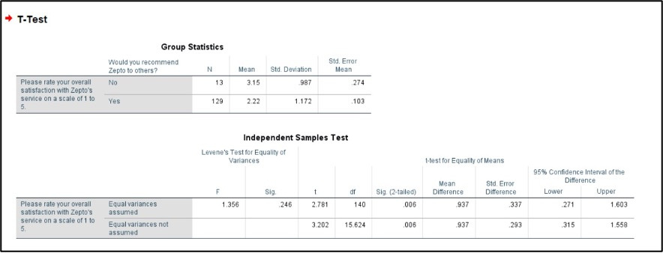
Zepto
Independent Sample T-Test
Overall satisfaction and recommended zepto
H0: There is no significant difference in overall satisfaction between users who recommend Zepto and those who do not.
H1: There is a significant difference in overall satisfaction between users who recommend Zepto and those who do not.

Slide 13
Zepto
Independent Sample T-Test
Interpretation:
1. Equality of Variances
F = 1.356, p = 0.246 (> 0.05)
Since p > 0.05, we assume equal variances for the t-test.
2. Independent Samples t-Test (Equal Variances Assumed)
t(140) = 2.781, p = 0.006 (< 0.05)
Since p < 0.05, we reject the null hypothesis (H₀) and conclude that there is a statistically significant difference in overall satisfaction between those who recommend Zepto and those who do not.
Mean Difference = 0.937, meaning that those who do not recommend Zepto have a higher satisfaction score than those who do.
95% Confidence Interval: (0.271 to 1.603) , Since this interval does not contain 0, the result is statistically significant.
3. Independent Samples t-Test (Equal Variances Not Assumed)
t(15.624) = 3.202, p = 0.006 (< 0.05)
Since p < 0.05, the conclusion remains the same.
those who do not recommend Zepto (No) have a higher satisfaction score than those who recommend Zepto (Yes), the interpretation is correct.

Slide 14
Zepto
Independent Sample T-Test
Key Findings:
The mean satisfaction score for users who do not recommend Zepto is higher than for those who do recommend it.
This suggests that users who do not recommend Zepto may have different expectations or service experiences than those who do.
Conclusion:
There is a significant difference in overall satisfaction between users who recommend Zepto and those who do not. However, the unexpected finding that non-recommenders have higher satisfaction suggests further investigation is needed to understand customer expectations and behavior.

Slide 15
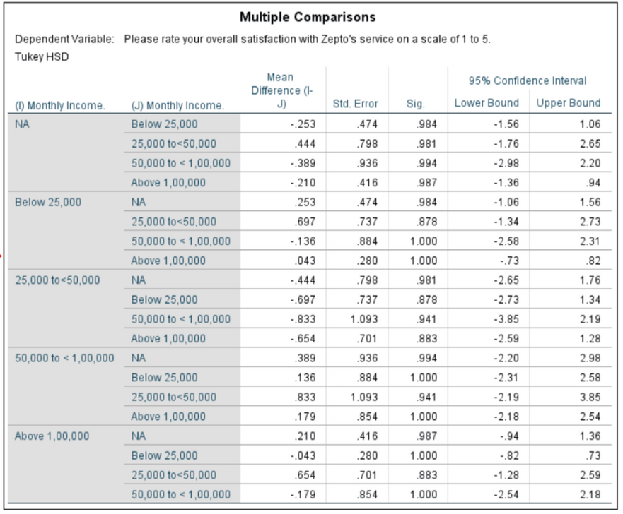
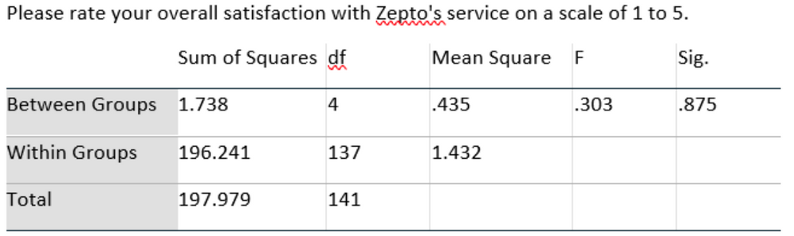
Zepto
ANOVA
Monthly Income vs. Overall Satisfaction:
H0: There is no significant difference in satisfaction levels across different monthly income groups.
H1: There is significant difference in satisfaction levels across different monthly income group.

Slide 16
Zepto
ANOVA
Monthly Income vs. Overall Satisfaction:
Interpretation:
Overall satisfaction and income group
The p-value (Sig.) = 0.8875, which is also greater than 0.05.
This indicates that there is no significant difference in satisfaction levels across different Income groups.

Slide 17
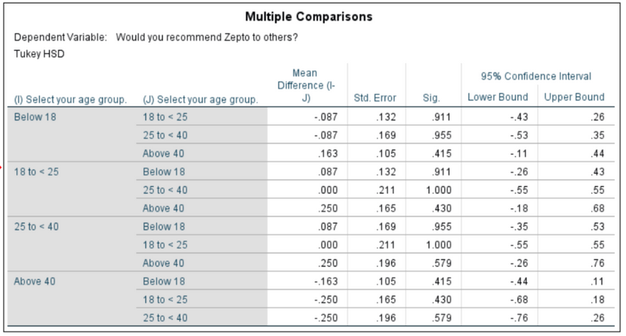
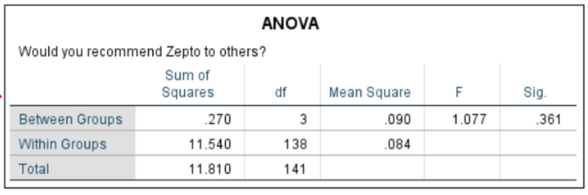
Zepto
ANOVA
Likelihood to Recommend vs. Age Group:
H0: There is no significant difference Likelihood to Recommend Zepto across difference Age group
H1: There is significant difference Likelihood to Recommend Zepto across difference Age group

Slide 18
Zepto
ANOVA
Likelihood to Recommend vs. Age Group:
Interpretation:
The p-value (Sig.) = 0.361, which is also greater than 0.05.
This indicates that there is no significant difference in recommendation likelihood across different age groups.
Age group does not significantly affect recommendation likelihood. The null hypothesis (H₀: No significant difference) is accepted, as the p-value (Sig.) = 0.361 is greater than 0.05.

Slide 19
Zepto
ANOVA
Key Findings:
Age groups typically have varying preferences and expectations.
Unexpected result as satisfaction level should varying upon different income groups.
Conclusion:
The unexpected findings suggest that while Zepto delivers consistent service quality, there may be underlying issues affecting customer loyalty and perceived value.

Slide 20

Zepto
Regression
Helps measure the impact of multiple independent variables (SERVQUAL dimensions) on overall satisfaction
Identifies the most significant service quality factor
Helps businesses focus on key improvement areas

Slide 21
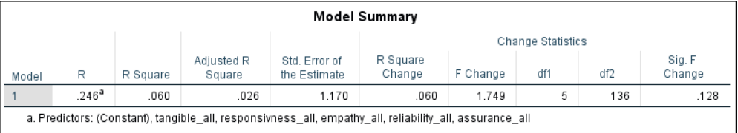
Zepto
Regression Analysis
Model summary
R = 0.246 (Weak correlation)This means customer satisfaction is not strongly influenced by reliability, responsiveness, assurance, empathy, and tangibles in your data.
R² = 0.060 ( Only 6% of variation in satisfaction is explained)The remaining 94% is influenced by other factors not included in the model (e.g., price, delivery time, brand reputation, personal preferences).
Adjusted R² = 0.026 (This suggests that adding more independent variables (dimensions) did not improve the model significantly.)

Slide 22
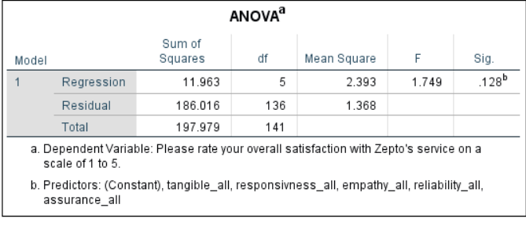
Zepto
Regression Analysis
Anova Result
F = 1.749, p = 0.128 ( Model is not statistically significant)
The low F-value (1.749) suggests that the variation in satisfaction explained by SERVQUAL dimensions is very small.
This suggests that, as a group, the SERVQUAL dimensions do not significantly predict customer satisfaction.

Slide 23
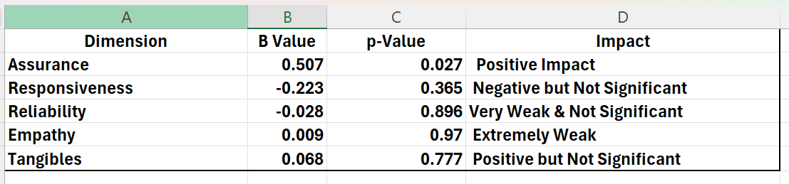
Zepto
Regression Analysis
Coefficients
Response time might affect satisfaction, but the data doesn’t strongly support this claim.
Assurance is the only statistically significant factor (p = 0.027), meaning trust and professionalism are the strongest drivers of satisfaction
Customers may not prioritize reliability, tangibility,empath as much as other factors.

Slide 24
Zepto
Regression Analysis
Key finding
Assurance (Competence,Courtesy,Credibility,Security) is the most critical factor for customer satisfaction.
Responsiveness (speed of response) has a negative but insignificant effect.
Reliability, Empathy, and Tangibles do not significantly impact satisfaction.
Other factors (like pricing, promotions, delivery speed) might influence satisfaction more.
Customers prioritize professionalism and trust more than responsiveness, reliability, or empathy. This suggests that Zepto should focus on building trust with users

Slide 25
Zepto
Regression
(Reccomendation for zepto)
Improve Assurance
🔹 Train customer support staff for professionalism & clear communication
🔹 Provide transparent policies & reliable service updates
Enhance Responsiveness
🔹 Reduce customer service wait times
🔹 Optimize app-based support for quick resolution
Less Focus on Reliability, Empathy, Tangibles
🔹 Maintain good design but prioritize functional improvements
🔹 Avoid over-investing in personalization if it’s not a major driver

Slide 26
Zepto
Overall Findings
Demographic Profile:
Respondents are predominantly male (69.7%), students (86.6%), under 18 years old (88.7%), and from high-income households (74.6% earn above ₹1,00,000/month)
Sample skews young and affluent, affecting generalizability
Service Quality Dimensions:
Assurance is the only significant driver of satisfaction
Customers value trustworthiness, knowledge, and transaction security over other aspects
The SERVQUAL dimensions together explain only 8% of satisfaction variance

Slide 27
Zepto
Overall Findings
Statistical Findings:
No significant differences in satisfaction across income groups or age groups
No significant relationship between usage frequency and satisfaction
Significant difference in satisfaction between recommenders and non-recommenders
Satisfaction Gap Analysis:
Moderate overall satisfaction (Mean: 2.30/5)
Low recommendation likelihood
Customers who don't recommend Zepto report higher satisfaction scores (paradoxical finding)

Slide 28
Zepto
Gap Analysis
Dimension | Expectation | Current Performance | Analysis Highlights | Recommended Actions
Reliability | 10-min delivery, accurate & consistent orders | Moderate performance with delivery delays | Statistical analysis shows significant gap between promised ultra-fast delivery and actual customer experience | Enhance order accuracy system, Optimize delivery logistics, Improve real-time tracking
Responsiveness | Prompt support, efficient problem resolution | Inconsistent customer service response | Despite 24/7 support claims, actual responsiveness falls short of customer expectations | Reduce checkout waiting times, Improve staff availability, Implement faster support channels
Assurance | Trustworthy service, knowledgeable staff | Confidence varies by customer segment | Only dimension significantly impacting satisfaction, explaining 8% of service variance | Comprehensive staff training, Develop consistent trust-building protocols, Enhance staff knowledge base
Tangibles | Modern app, professional delivery, quality packaging | Relatively acceptable physical aspects | Customers may value operational elements beyond visual design | Maintain clean, organized service points, Continuous app interface improvements, Refine packaging presentation
Empathy | Personalized, individualized attention | Inconsistent personalization | Significant gap between expected personalized service and actual delivery | Develop gender-specific service strategies, Train staff on personalized customer engagement, Create tailored customer interaction protocols

Slide 29
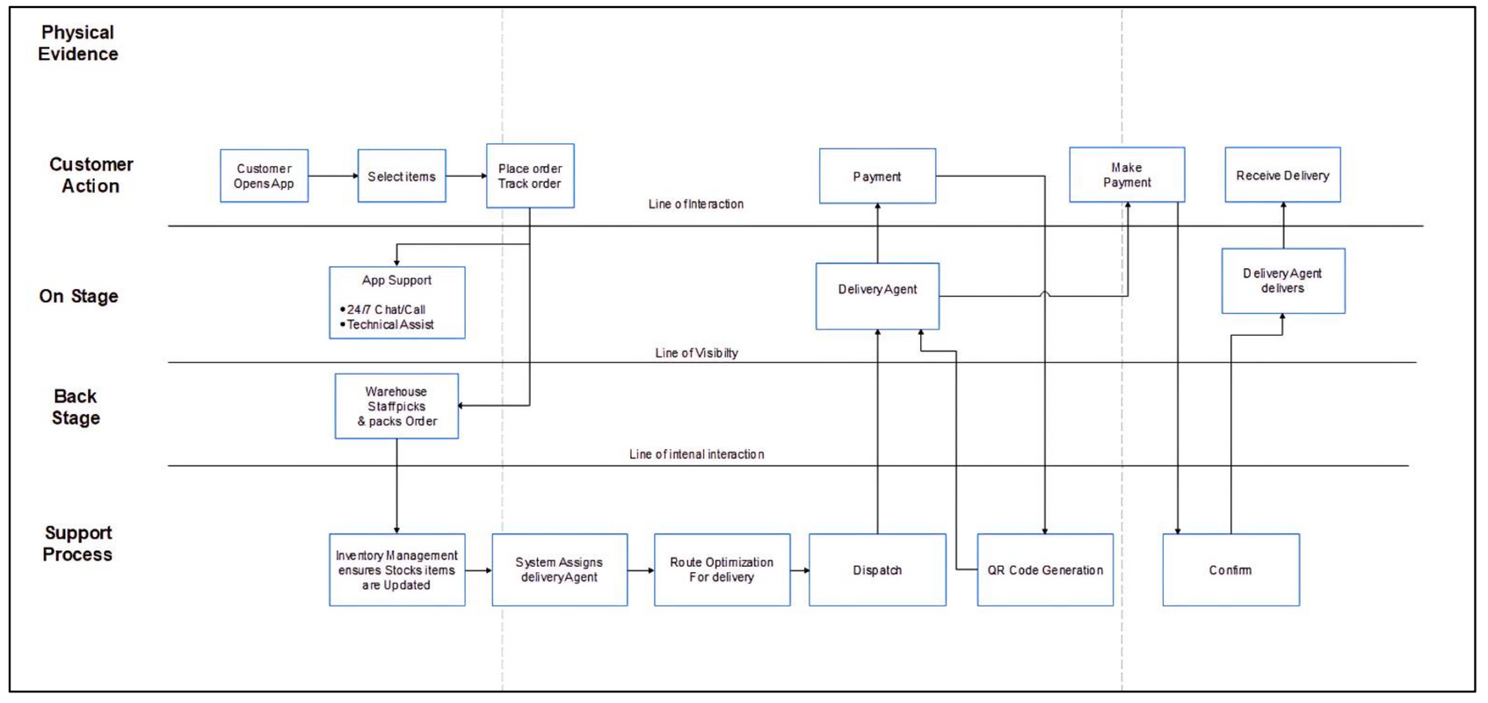
Zepto
Service Blueprint
carry bag , Delivery boy uniform , packaging , mobile app,hygine

Slide 30
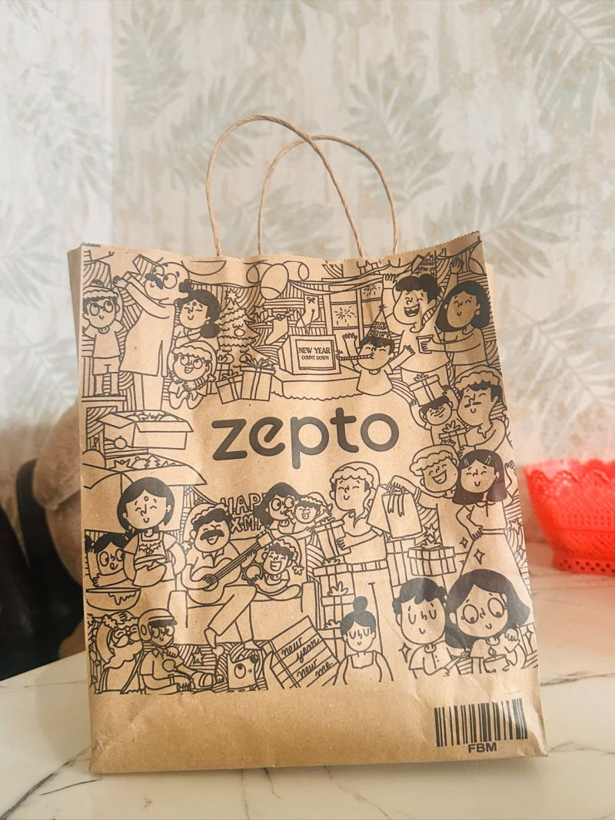

Zepto
ZEPTO PACKAGING
Zepto follows a standardized and efficient packaging system to ensure quick, safe, and fresh deliveries.

Slide 31
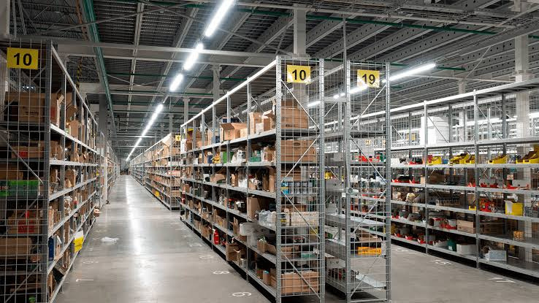
Zepto
ZEPTO DARK STORES
Zepto uses these stores to store, pack, and dispatch groceries within minutes, enabling their 10-minute delivery service.

Slide 32
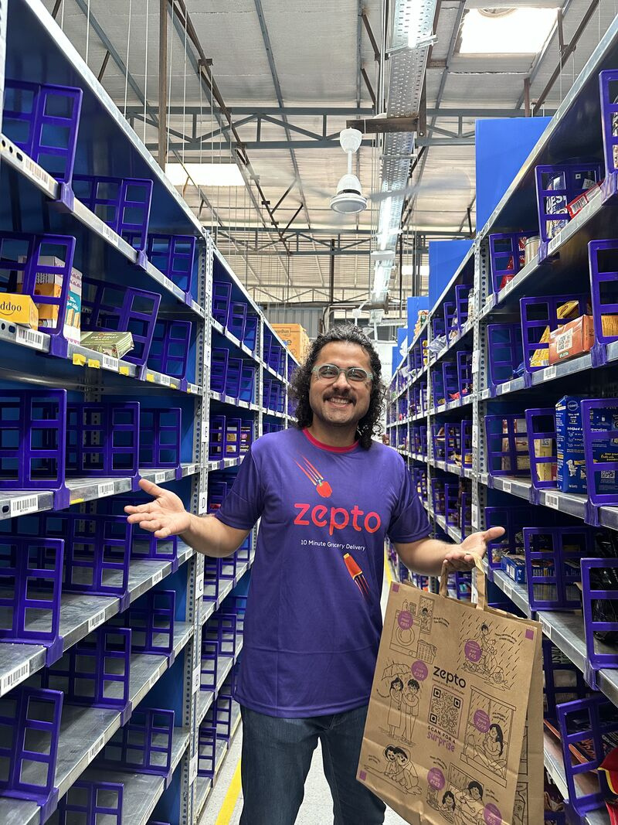
Zepto
ZEPTO DELIVERY UNIFORM
Zepto ensures its delivery riders are easily recognizable with a branded uniform and gear designed for comfort, visibility, and efficiency.

Slide 33
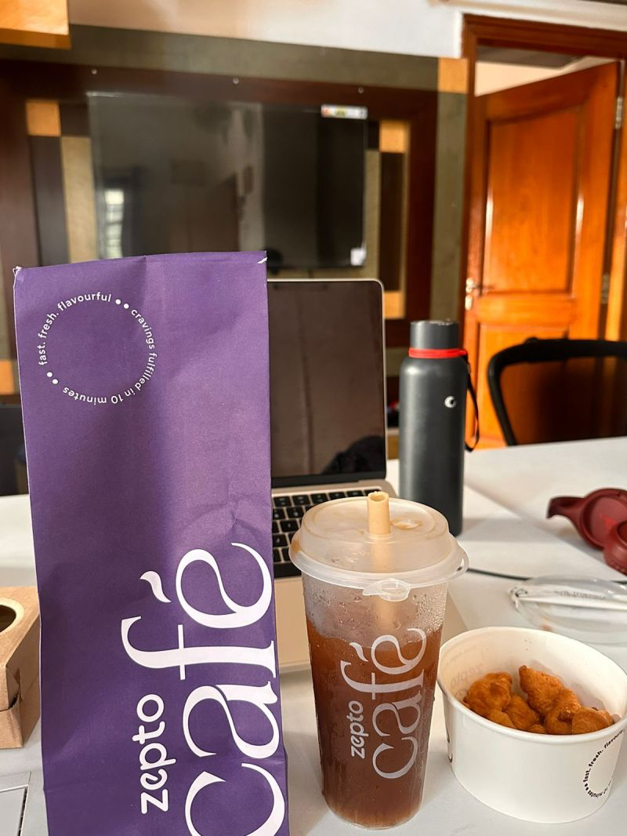
Zepto
ZEPTO HYGIENE-SEALED
Zepto ensures safe, tamper-proof, and hygienic packaging for Food and essentials with hygiene-sealed bags & containers to maintain product integrity.

Slide 34
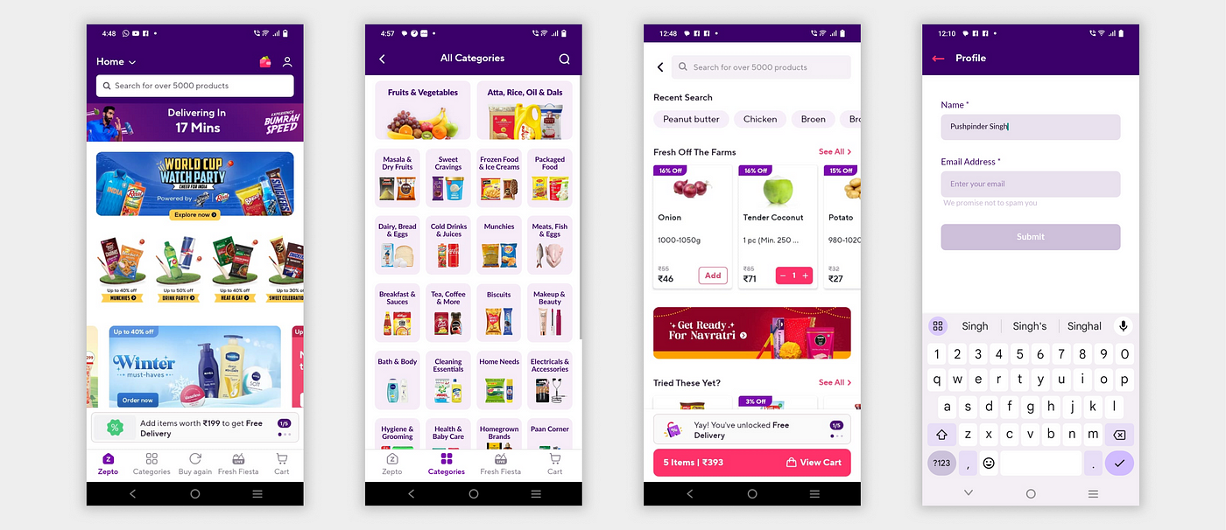
ZEPTO MOBILE APPLICATION
The Zepto mobile app is the core of its quick commerce model, enabling users to order groceries and essentials with super-fast delivery (10 minutes).
Zepto

Slide 35

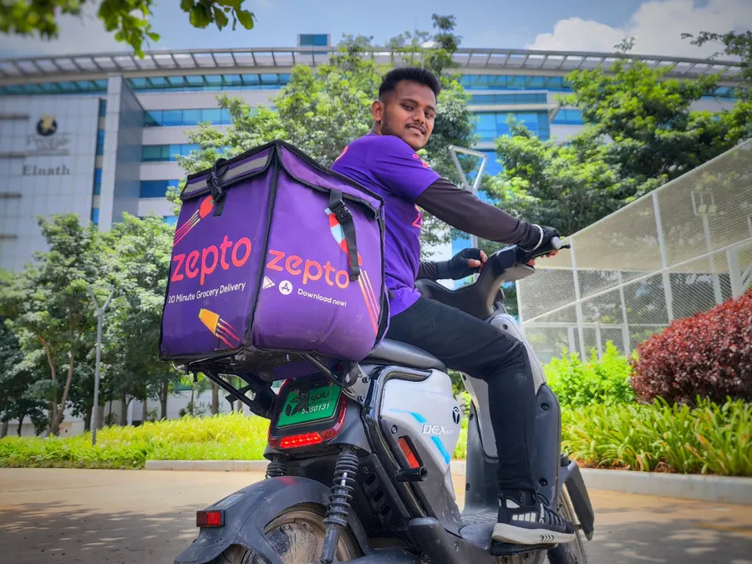
Zepto
ZEPTO DELIVERY BAG
Zepto’s delivery bags are specially designed insulated backpacks that ensure groceries are delivered fresh, secure, and intact within 10 minutes.

Slide 36
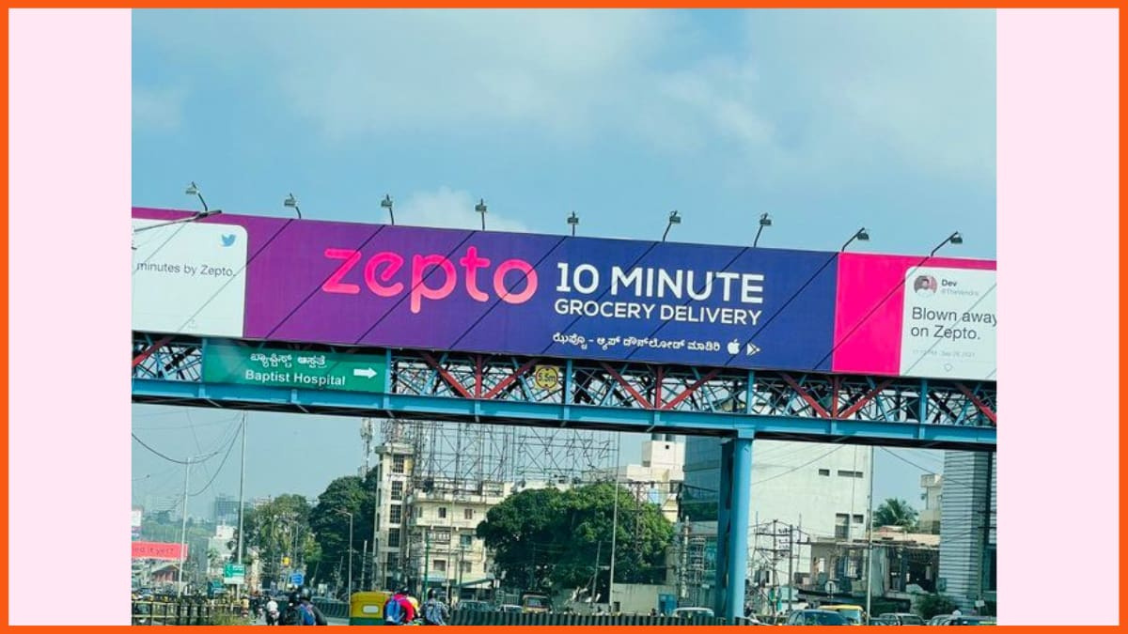
Zepto
ZEPTO ADVERTISING
Zepto’s advertising strategy focuses on brand awareness, speed, and convenience to attract customers in the competitive quick commerce market.

Slide 37
Zepto
Thank You

